Slide 1
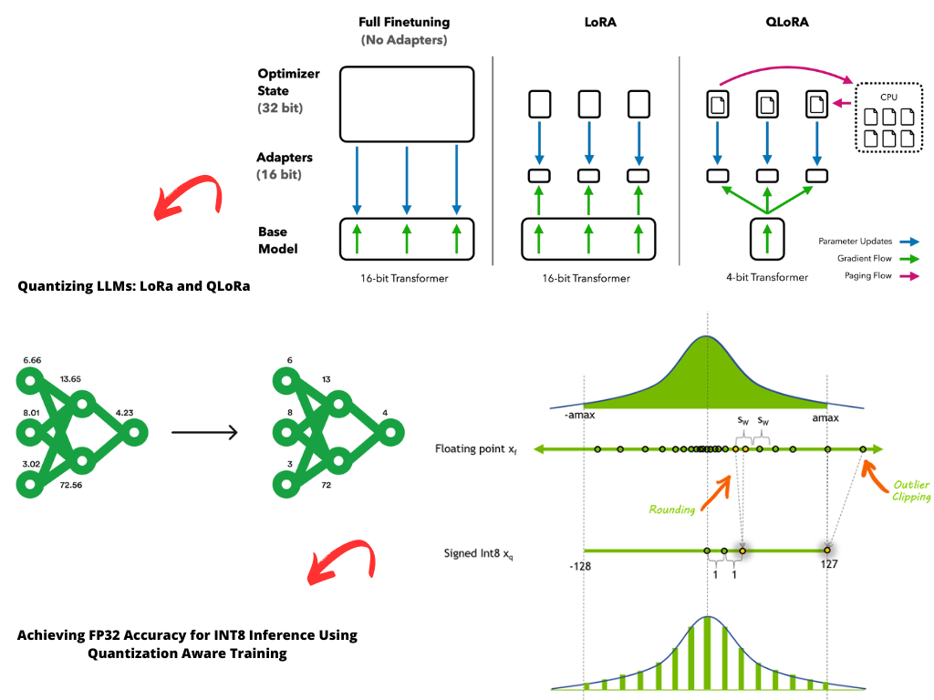
ZIPPING LLMs: Quantization & Off-loading
Visit
Murat Karakaya Akademi YouTube Channel
for the tutorial video
Notes:
NOTE:
To change the image on this slide, select the picture and delete it. Then click the Pictures icon in the placeholder to insert your own image.

Slide 2

Content
The Need for Optimization: LLMs are huge!
How to zip LLMs
Quantization: Packing More Value in Less Space
Off-loading: Sharing the Burden
Demo: Run Mixtral-8x7B Model on Google Colab’s Free Version

Slide 3
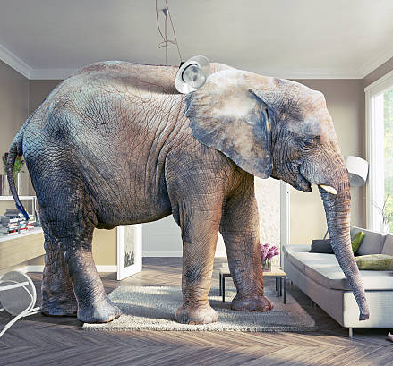
The Problem with LLMs: LLMs are huge!
Here are some Large Language Models (LLMs) and their VRAM requirements for inference without any quantization:
GPT3: Requires 350 GB VRAM
Bloom: Requires 352 GB VRAM
Llama-2-70b: Requires 140 GB VRAM
Falcon-40b: Requires 90 GB VRAM
MPT-30b: Requires 60 GB VRAM
bigcode/starcoder: Requires 31 GB VRAM
Jurassic-1 Jumbo: Requires 150 GB VRAM
PaLM-540B: Requires 320 GB VRAM

Slide 4

The Problem with LLMs: LLMs are huge!
Without Quantization:
Falcon-40B: Approximately 90 GB of VRAM
Falcon-180B: Approximately 640 GB of VRAM
With Quantization:
Falcon-40B:
Q-4bit: 45 GB of VRAM
Q-8bit: 60 GB of VRAM
Falcon-180B:
Q-4bit: 95 GB of VRAM
Q-8bit: 70 GB of VRAM

Slide 5
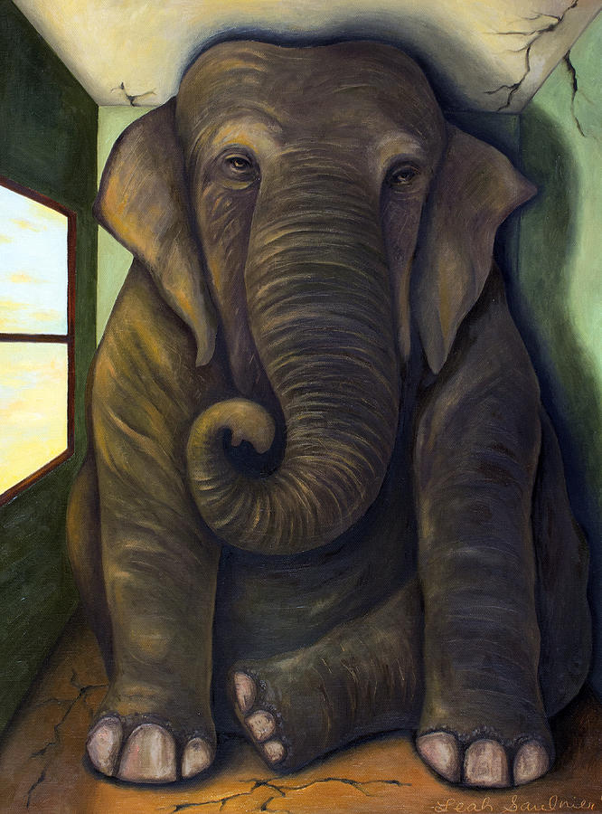
The Problem with LLMs: LLMs are huge!
With Quantization:
GPT3: For 8-bit quantization, a 13B parameter model requires more than 24GB VRAM.
Bloom: For 8-bit quantization, a 176B parameter model requires more than 352GB VRAM. For 4-bit quantization, it requires at least 176GB VRAM.
Llama-2-70b: For 8-bit quantization, a 70B parameter model requires approximately 70-80GB of VRAM. For 4-bit quantization, it requires at least 35GB VRAM.
Falcon-40b: For 8-bit quantization, it requires more than 40GB VRAM. For 4-bit quantization, it requires at least 35GB VRAM.
MPT-30b: For 8-bit quantization, it requires less than 22GB VRAM.
bigcode/starcoder: For 4-bit quantization, it requires approximately 11GB VRAM.
Note that these are approximate values.

Slide 6
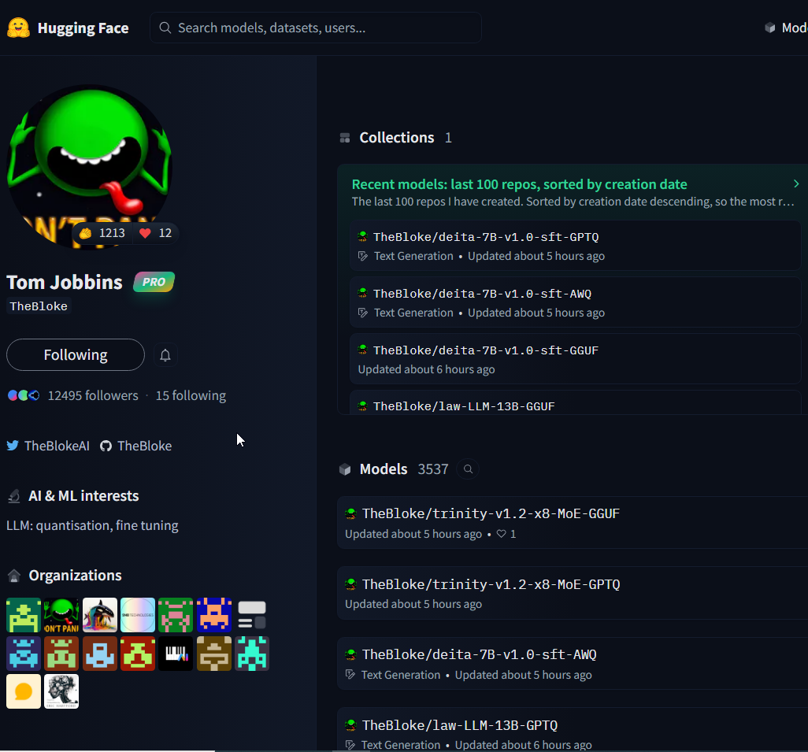
The Problem with LLMs: LLMs are huge!
You can access the quantized versions of the most of the LLMs on the HF Bloke’s account:
https://huggingface.co/TheBloke
https://huggingface.co/TheBloke/Mistral-7B-Instruct-v0.1-GPTQ

Slide 7
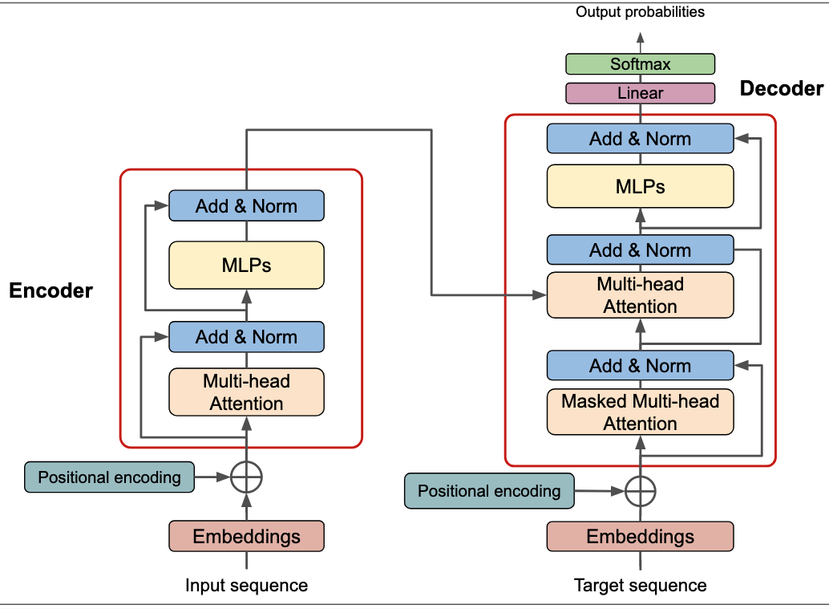
Quantization & LLMs: Understanding LLM Internals
Embedding Layer:
Maps words from the vocabulary to dense vectors in a high-dimensional space.
Captures semantic relationships between words and helps the model understand the meaning of text.
Transformer Blocks:
Core building blocks of LLMs.
Consist of self-attention layers and feed-forward layers.
Handle long-range dependencies in text and capture semantic relationships.
Dense Layers:
Fully connected layers often used in LLM output stages.
Combine information from previous layers to generate final predictions or classifications.

Slide 8
Quantization & LLMs: Understanding LLM Internals:
Each layer plays a crucial role in LLM architecture.
Embedding layers represent words as vectors, enabling the model to grasp semantic relationships
Transformer blocks excel at understanding long-range dependencies and semantic relationships.
Dense layers integrate information for final predictions or classifications.

Slide 9
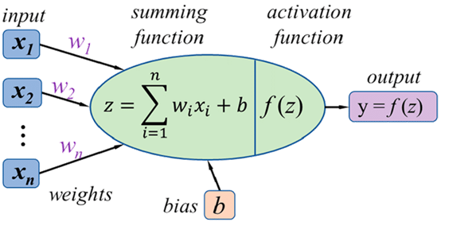
Quantization & LLMs: Understanding LLM Internals:
All three layers - Transformer Blocks, Dense Layers, and Embedding Layers - heavily rely on weights and biases for their functionality and learning
Weights & Biases:
Numerical values that determine the strength of connections between neurons, representing knowledge learned during training.
Numerical values that adjust overall activation levels, allowing for fine-tuning of model behavior.

Slide 10
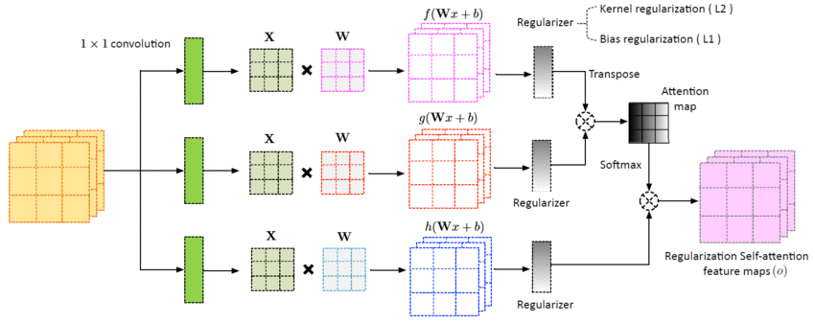
Quantization & LLMs: Understanding LLM Internals:
Transformer Blocks: + Dense Layers → Weights: & Biases → Matrix Operations → Store Numeric Values

Slide 11
Quantization & LLMs
Understanding weights and biases is crucial for quantization because:
Quantization primarily targets these numerical values for reduction in precision.
By strategically reducing the number of bits used to represent weights and biases, model size and computational costs can be significantly reduced.
The challenge lies in finding the optimal quantization levels that maintain model accuracy while achieving desired efficiency gains.

Slide 12
Quantization & LLMs
Quantization's Aim:
Reduce model size and computational complexity while minimizing performance impact.
Achieved by reducing the precision of weights and activations in model layers.

Slide 13
Quantization & LLMs: Quantization Steps
Mapping to a Smaller Representation:
Rescale weights and activations from their original range (e.g., 32-bit floating-point) to a lower-precision format (e.g., 8-bit integers).
Example: Map a weight value of 0.456789 to the nearest 8-bit integer value (0-255), potentially becoming 115.
Calibration:
Find optimal mapping ranges to minimize information loss during quantization.
Crucial for preserving model accuracy.

Slide 14
Quantization & LLMs: Quantization Steps
Embedding Quantization:
Apply quantization to word embeddings, the numerical representations of words.
Reduces memory footprint and potentially improves efficiency of attention computations.
Transformer Block Quantization:
Quantize weights and activations within self-attention and feed-forward layers.
Techniques like mixed-precision quantization can preserve accuracy while reducing computational costs.
Dense Layer Quantization:
Apply quantization to weights and activations in dense layers.
8-bit quantization often works well for dense layers without significant accuracy degradation.

Slide 15
Quantization & LLMs
An example for Dense Layer Quantization:
Consider a hypothetical Dense Layer with:
Input: 1000 neurons
Output: 500 neurons
Weights: 500,000 (1000 * 500) floating-point numbers, each typically occupying 32 bits (4 bytes) of memory.
Biases: 500 floating-point numbers, also using 32 bits each.
NOTE: Each weight and bias are represented with 4 bytes!

Slide 16
Quantization & LLMs
Example 1 for Dense Layer Quantization:
Quantizing to 8-bit integers:
Mapping: Each weight and bias value is mapped to an 8-bit integer (0-255), reducing memory usage per value to 1 byte.
Calibration: An algorithm determines optimal mapping ranges to minimize accuracy loss.
Storage: Weights and biases now occupy only 500KB (500,000 * 1 byte) and 500 bytes, respectively, a 4x reduction from 2MB (4 bytes per value).
Computation: Inference calculations use optimized integer arithmetic for 8-bit values, often faster than floating-point operations on modern hardware.

Slide 17
Quantization & LLMs
Example 2 for Dense Layer Quantization:
Assume a hypothetical dense layer with 4 input neurons and 3 output neurons:
Original 32-bit Floating-Point Weight Matrix:
[[0.54321, -0.23456, 0.98765],
[0.12345, 0.67890, -0.34567],
[-0.87654, 0.45678, 0.01234],
[0.56789, -0.90123, 0.23456]]

Slide 18
Quantization & LLMs
Example 2 Cont.:
Quantizing to 8-bit Integers with a range of 0 to 255:
Determine Range and Scaling Factor:
Find the minimum and maximum values in the matrix:
Min = -0.90123
Max = 0.98765
Calculate the scaling factor to map values to 0-255:
Scaling Factor = 255 / (Max - Min) = 255 / (0.98765 + 0.90123) ≈ 135.00063

Slide 19
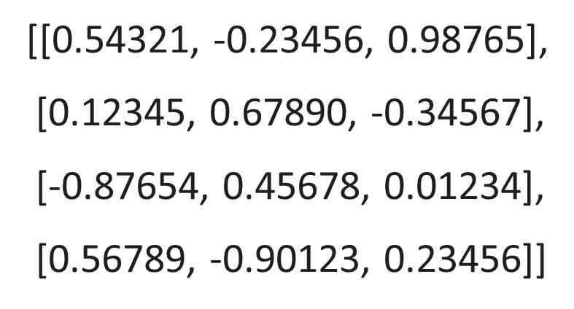
Quantization & LLMs
Example 2 Cont.:
2. Center Values: Subtract the minimum value of the matrix from all elements before scaling.
[[1.44444, 0.66667, 1.88888], [1.02468, 1.58013, 0.55556],
[0.02469, 1.35801, 0.91357],
[1.46912, 0.00000, 1.13579]]

Slide 20
Quantization & LLMs
Example 2 Cont.:
3. Map Values to 8-bit Integers:
Multiply each value by the scaling factor
[[1.44444, 0.66667, 1.88888], [1.02468, 1.58013, 0.55556],
[0.02469, 1.35801, 0.91357],
[1.46912, 0.00000, 1.13579]]
[[194.9998, 89.9999, 254.9998],
[138.2918, 213.3176, 75.0003],
[3.3333, 183.3314, 123.3332],
[198.3316, 0.0000, 153.3331]]

Slide 21
Quantization & LLMs
Example 2 Cont.:
3. Map Values to 8-bit Integers:
round to the nearest integer:
[[194.9998, 89.9999, 254.9998],
[138.2918, 213.3176, 75.0003],
[3.3333, 183.3314, 123.3332],
[198.3316, 0.0000, 153.3331]]
[[195, 90, 255],
[138, 213, 75],
[3, 183, 123],
[198, 0, 153]]

Slide 22
Quantization & LLMs
Original 32-bit Floating-Point Quantized 8-bit Integer Weight Matrix Weight Matrix
[[0.54321, -0.23456, 0.98765],
[0.12345, 0.67890, -0.34567],
[-0.87654, 0.45678, 0.01234],
[0.56789, -0.90123, 0.23456]]
[[195, 90, 255],
[138, 213, 75],
[3, 183, 123],
[198, 0, 153]]

Slide 23
Quantization & LLMs
Benefits of Quantization:
Reduced Model Size: Up to 4x smaller, enabling deployment on devices with limited memory.
Acceleration: Potential speedup due to efficient integer arithmetic
Faster Inference: Up to 2-3x faster processing, leading to quicker responses.
Lower Energy Consumption: Reduced computational demands, making LLMs more energy-efficient.

Slide 24
Quantization & LLMs
Considerations and Challenges:
Accuracy Trade-offs: Quantization can introduce slight accuracy loss. Careful calibration and technique selection are crucial.
Hardware Compatibility: Ensure hardware supports efficient low-precision operations for optimal benefits.

Slide 25
An Overview of Quantization Methods
Post-Training Quantization (PTQ):
Applies after model training.
Reduces precision of model weights, often from 32-bit to 8-bit, saving memory and speeding up inference.
Examples: PTQ, 4-bit NormalFloat (NF4), QLoMP.
Quantization-Aware Training (QAT):
Incorporates quantization during training.
Helps the model adapt to lower precision for better accuracy.
Examples: QAT, LLM-QAT, QiloRA.
Efficient Fine-Tuning with Quantization:
Combines quantization with efficient fine-tuning techniques for faster adaptation and memory savings.
Examples: LoRA, EfficientDM.
Other Quantization Techniques:
Use different strategies to reduce model size.
Examples: Weight Clustering, OdysseyLLM, Eager Mode Quantization, FX Graph Mode Quantization.

Slide 26
Quantization & LLMs
LLM Name | Original VRAM (GB) | Quantized VRAM (Q-4bit) (GB) | VRAM Reduction (%)
GPT-3 | 140 | 35 | 75%
Jurassic-1 Jumbo | 150 | 40 | 73%
Bloom | 150 | 35 | 75%
Megatron-Turing NLG | 300 | 75 | 75%
PaLM | 320 | 80 | 75%
Chinchilla | 75 | 20 | 73%
Falcon-40B | 90 | 45 | 50%
Falcon-180B | 450 | 95 | 78%

Slide 27

Content
The Need for Optimization: LLMs are huge!
How to zip LLMs
Quantization: Packing More Value in Less Space
Off-loading: Sharing the Burden
Demo: Run Mixtral-8x7B Model on Google Colab’s Free Version

Slide 28
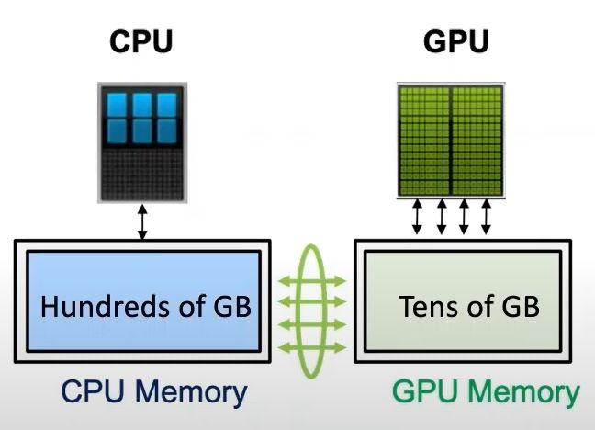
Understanding Off-loading
Off-loading is a technique used to manage the computational and memory demands of large models like LLMs.
It involves moving some of the computational tasks from the GPU (Graphics Processing Unit) to the CPU (Central Processing Unit), thereby freeing up GPU resources.
Example: Consider a scenario where you’re trying to run a large language model (LLM) like Mixtral-7B on a standard GPU. The model’s parameters size exceeds the GPU’s memory capacity. To manage this, we can use off-loading.

Slide 29
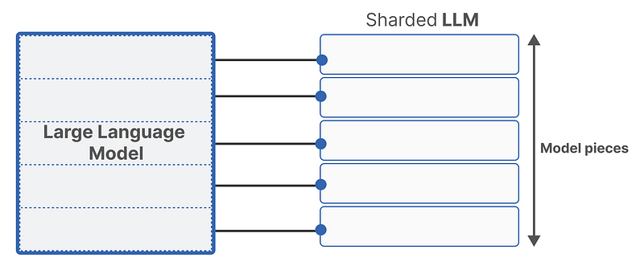
How does Off-loading work in LLMs?
Model Sharding:
The parameters of the LLM are divided into smaller parts or “shards”. Each shard is small enough to fit into the GPU memory.
This is similar to how large files are broken down into smaller parts for easier management and processing.

Slide 30
How does Off-loading work in LLMs?
Model Sharding:
Loading Shards:
When the model needs to perform computations involving a particular set of parameters, the corresponding shard is loaded into the GPU memory.
This is similar to how an application loads only the necessary parts of a file into memory when it’s being used.

Slide 31
How does Off-loading work in LLMs?
Model Sharding:
Loading Shards:
Computation:
The GPU performs the necessary computations using the loaded parameters.

Slide 32
How does Off-loading work in LLMs?
Model Sharding:
Loading Shards:
Computation:
Off-loading:
Once the computations for a particular shard are completed, the shard is off-loaded from the GPU memory, making room for the next shard.
This is similar to how an application frees up memory once it’s done processing a part of a file.

Slide 33

How does Off-loading work in LLMs?
Model Sharding
Loading Shards
Computation
Off-loading
This process is repeated until all necessary computations for the entire model have been completed.

Slide 34
Why is Off-loading Important?
The off-loading technique allows for the use of LLMs even on hardware with limited GPU memory.
It also enables faster loading, usage, and fine-tuning of LLMs.
By using off-loading, researchers and developers can run large models on standard hardware, making these powerful models more accessible.
Furthermore, off-loading can improve the efficiency of applications by ensuring that resources are used optimally.

Slide 35
Off-loading Libraries
DeepSpeed: Developed by Microsoft Research, it's a comprehensive library for optimizing large model training and inference.
Offers various off-loading techniques, including: Zero-Redundancy Optimizer (ZeRO) for memory optimization, DeepSpeed Sparse Attention for efficient handling of sparse models, Pipeline parallelism for distributing model across multiple GPUs
It’s highly optimized for PyTorch and is used in training large models like Megatron-Turing NLG.
Megatron-LM: An open-source library from NVIDIA specifically designed for training LLMs with billions of parameters.
Provides model parallelism and pipeline parallelism for efficient distribution across multiple GPUs and nodes.
Integrates with DeepSpeed for additional optimization features.

Slide 36
Off-loading Libraries
FairScale: A library from Facebook AI Research for scaling deep learning models.
Focuses on simplifying model parallelism and pipeline parallelism for PyTorch models.
Offers features for memory-efficient model training and inference, including off-loading techniques.
Hugging Face Transformers:
While primarily a library for working with LLMs, it has built-in support for DeepSpeed and FairScale for off-loading.
This allows you to easily leverage off-loading techniques within the familiar Transformers framework.

Slide 37
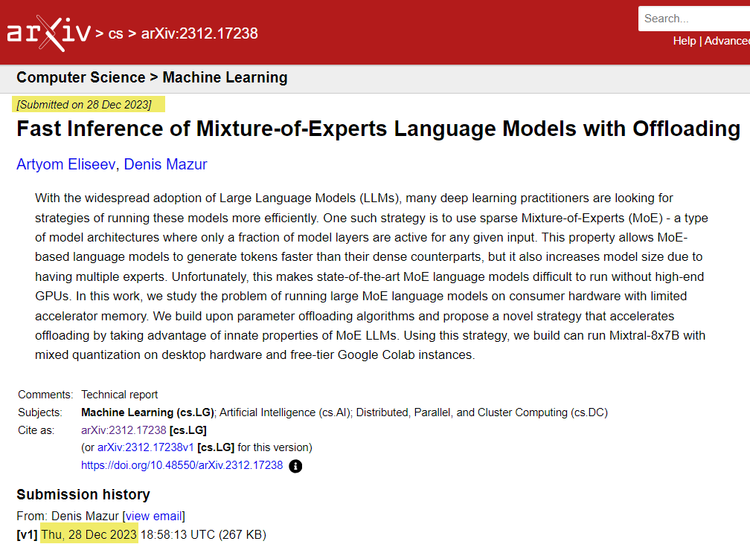
Off-loading Libraries
Mixture-of-Experts (MoE) Language Models with Offloading:
This approach uses sparse Mixture-of-Experts (MoE) - a type of model architecture where only a fraction of model layers are active for any given input.
This property allows MoE-based language models to generate tokens faster than their dense counterparts, but it also increases model size due to having multiple experts.
https://arxiv.org/abs/2312.17238

Slide 38
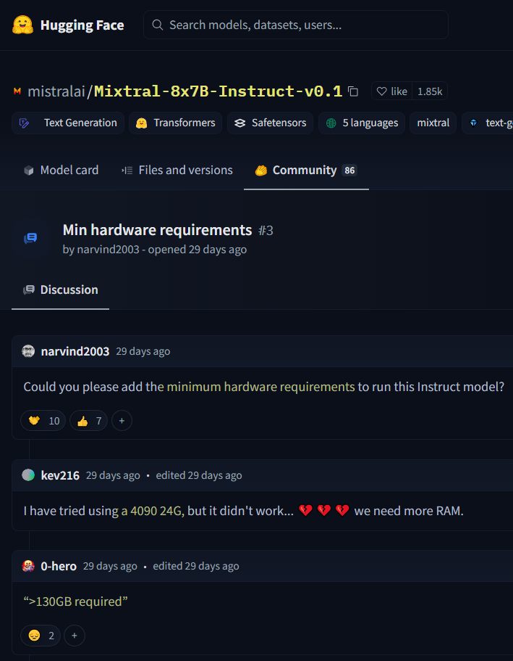
Off-loading Libraries
Mixture-of-Experts (MoE) Language Models with Offloading:
https://arxiv.org/abs/2312.17238

Slide 39
Content
The Need for Optimization: LLMs are huge!
How to zip LLMs
Quantization: Packing More Value in Less Space
Off-loading: Sharing the Burden
Demo: Run Mixtral-8x7B Model on Google Colab’s Free Version

